Slide 1
Amortized Analysis

Slide 2
Amortized analysis:
  Guarantees the avg. performance of each operation in the worst case.
  Aggregate method
  Accounting method
  Potential method
Aggregate method
  A sequence of n operations takes worst-case time T(n) in total. In the worst case, the amortized cost (average cost) per operation is T(n)/n

Slide 3
  Eg.1 [Stack operation]
  PUSH(S,x): pushes object x onto stack S
  POP(S): pops the top of stack S and return the popped object
  Each runs in O(1) time (假設只需一單位時間)
  故 n 個 PUSH 和 POP operations 需 Θ(n) time
  考慮 MULTIPOP(S, k): pops the top k objects of stack S
  MULTIPOP(S, k)
  While not STACK-EMPTY(S) and k≠0
  do { POP(S)
  k ← k-1 }
  故執行一 MULTIPOP 需 min{s, k} 個步驟

Slide 4
  問題: 執行上述 PUSH, POP, MULTIPOP n次
  假設 initial stack 為 empty
  試問每一 operation 在 worst-case 之 amortized cost?
  Each object can be popped at most once for each time it is pushed.
  上述問題只需 O(n) time
  O(n)/n = O(1) 每個 operation 平均所需的時間

Slide 5
  Eg.2 [Incrementing a binary counter]
  A k-bit binary counter, counts upward from 0
  A[k-1] A[k-2]…A[1] A[0]
  highest order bit lowest order bit
  Increment(A)
  { i ← 0;
  while i<length[A] and A[i]=1
  do A[i] ← 0;
  i ← i+1;
  if i<length[A]
  then A[i] ← 1;
  }
  Ripple-carry counter
A[7]A[6]A[5]A[4]A[3]A[2]A[1]A[0]
0 0 0 0 0 0 0 0
0 0 0 0 0 0 0 1
0 0 0 0 0 0 1 0
0 0 0 0 0 0 1 1
0 0 0 0 0 1 0 0
0 0 0 0 0 1 0 1
0 0 0 0 0 1 1 0
0 0 0 0 0 1 1 1
0 0 0 0 1 0 0 0
0 0 0 0 1 0 0 1
0 0 0 0 1 0 1 0
0 0 0 0 1 0 1 1
0 0 0 0 1 1 0 0

Slide 6
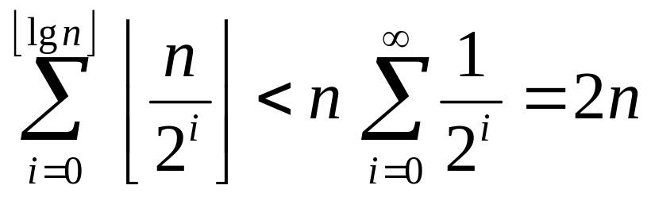
  問題: 執行 n 次(依序) Increment operations.
  在 worst-case 每一operation 之 amortized cost 為何?
  A[0] 每 1 次改變一次
  A[1] 每 2 次改變一次
  A[i] 每 2^{i} 次改變一次
  故 amortized cost of each operation 為 O(n)/n = O(1)

Slide 7
Accounting method:
  Assign differing charges to different operations
  close to actual charge
  (amortized cost)
  If the amortized cost > actual cost, the difference is treated as credit
  (在aggregate method所有operation有相同的amortized cost)
  選擇(定義)每一operation之適當 amortized cost 需注意:
  1. 若要每一 op 在 worst-case 之平均 cost小, 則一串
  operations 之 total amortized cost必須 ≥ total actual cost
  2. Total credit 必須是非負

Slide 8
  Eg. 1 [Stack operation]
  Amortized cost: PUSH 2 , POP 0 , MULTIPOP 0
  Actual cost: PUSH 1 , POP 1 , MULTIPOP min(k,S)
  在 PUSH 之 amortized cost 中預支了 POP 時所需之 cost
  故在 n 個運作之後, total amortized cost = O(n)
  Eg. 2 [Increment a binary counter]
  Set a bit to 1: amortized cost 2
  Reset a bit to 0: amortized cost 0
  在 Increment procedure 中每次最多只 set 一個 bit 為 1
  故每次最多 charge 2,
  執行 n 次 Increment 其 total amortized cost = O(n)

Slide 9


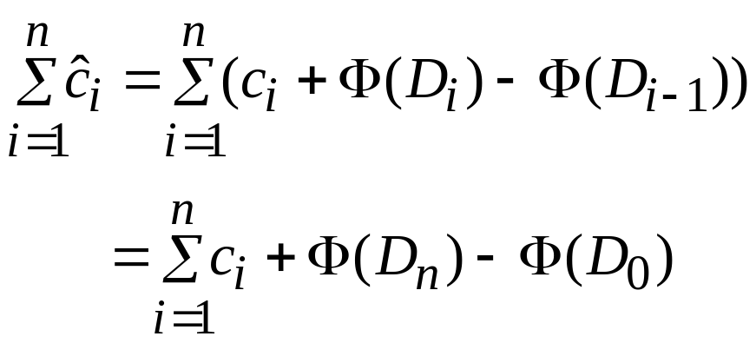
Potential method
  D₀ : initial data structure
  c_{i} : actual cost of the i-th operation
  D_{i} : data structure after applying the i-th operation to D_{i-1}
  Φ : potential function
  Φ(D_{i}) is a real number
  : the amortized cost of the i-th operation
  w.r.t potential function is
  若 Φ(D_{n}) ≥ Φ(D₀), 則 total amortized cost 為 total actual
  cost 之一 upper bound

Slide 10
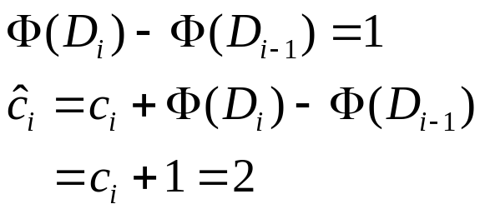
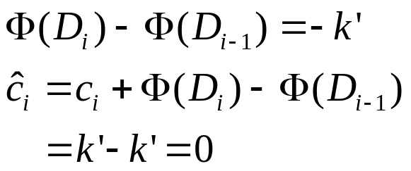

  Eg. 1 [Stack operation]
  定義 potential function Φ: stack size
  Φ(D₀)=0, 亦知 Φ(D_{i}) ≥ 0
  i-th op.
  PUSH:
  MULTIPOP(S, k): 令 k’=min{k,S}
  POP: 同理
  所以一序列 n 個 op 之 total amortized cost 為 O(n)

Slide 11
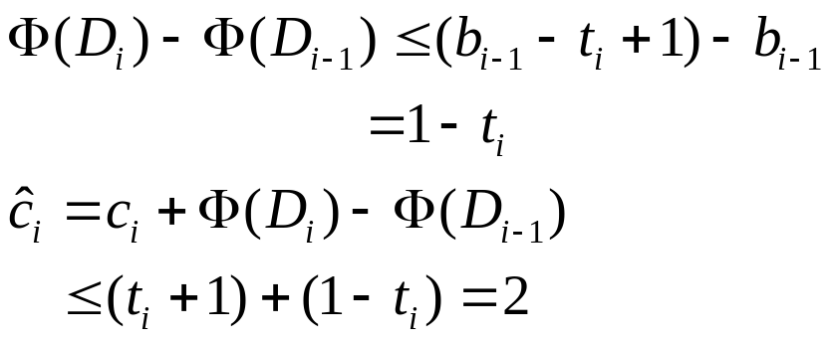
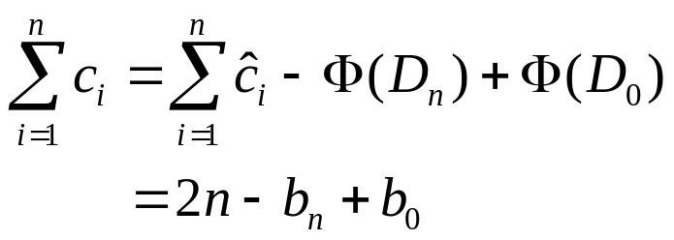
  Eg. 2 [Incrementing a binary counter]
  對 counter 而言其 potential function 值為在 i-th op 後
  被設定為 1 的 bit 個數
  b_{i} = # of 1’s in the counter after the i-th operation
  Suppose that the i-th Increment op. resets t_{i} bits
  Actual cost ≤ t_{i}+1
  # of 1’s in the counter after the i-th op.:
  b_{i} ≤ b_{i-1} – t_{i} + 1

Slide 12
  Implement a Queue with two Stacks:
  Stack A : Dequeue
  Stack B : Enqueue
  S_{B} : stack size of B
  Enqueue(x)
  { PUSH(B, x) }
  Dequeue(Q)
  { if Empty(Q) then return “empty queue”;
  else if Empty(A) then
  while not Empty(B)
  do PUSH(A, POP(B);
  POP(A);
  }
front
rear
Stack A
Stack B

Slide 13
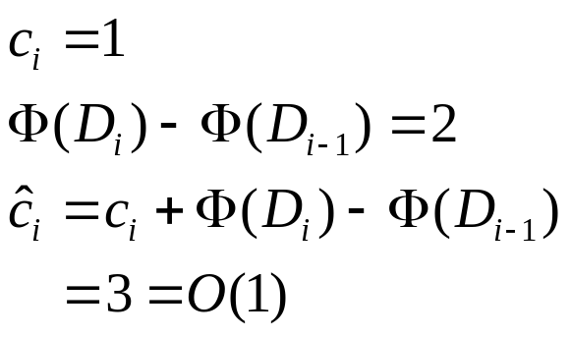
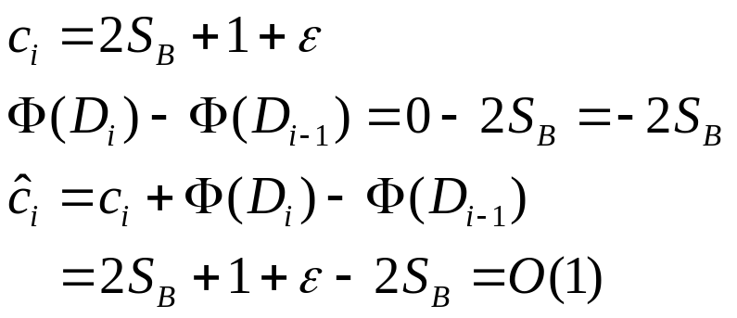
  Φ(D_{i})=2[stack size of B after the i-th operation]
  Enqueue:
  Dequeue:

Slide 14


Dynamic tables:
Operations: Table-Delete, Table-Insert
Load factor: = (number of items)/(table size)
Define the load factor of an empty Table as 1.
Table T:
i | 100 | 11 | 7
Notes:
Dynamic tables:

Slide 15
Table expansion:
Table-Insert(T, x)
{ if size[T]=0 then allocate table[T] with 1 slot
size[T]=1;
if num[T]=size[T] then
{ allocate new-table with 2*size[T] slots; ⬅ Expansion
insert all items in table[T] into new-table;
free table[T];
table[T] = new-table; size[T] = 2*size[T];}
insert x into table[T];
num[T]= num[T] + 1;}

Slide 16


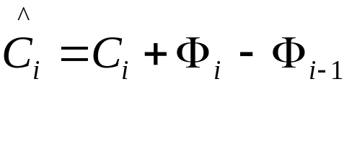
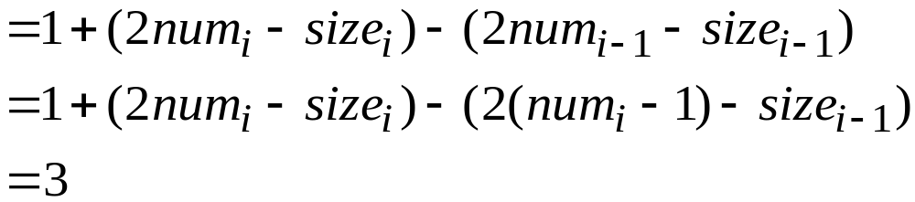

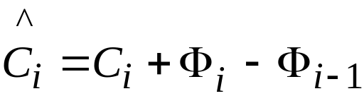
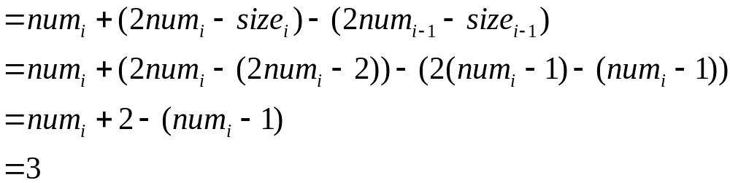
Define potential function
No expansion after the ith op:
With expansion after the ith op:

Slide 17
Table expansion and contraction:
I, D, I, I, D, D, I, I, I………. : A sequence of n operations.
Preserve two properties:
. Load factor is bounded below by a constant.
. The amortized cost of a table op is bounded above by a const.
Strategy:
.Double the table size when an item is inserted into a full table.
.Halve the table size when a deletion causes the table to become
less than ¼ full.

Slide 18
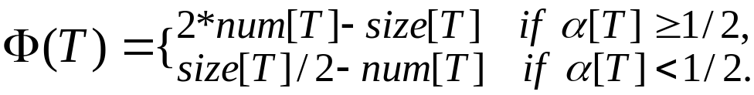
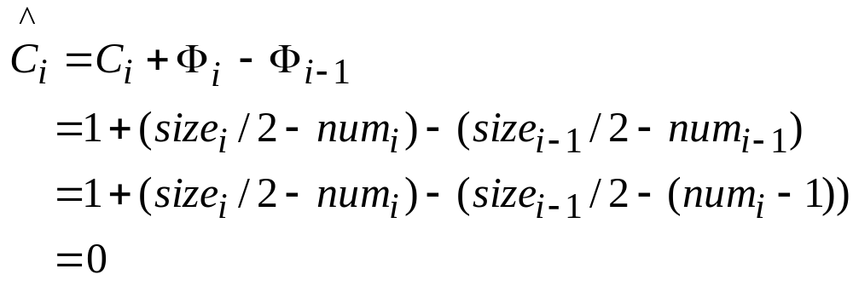
Define potential function:
If the i-th operation is Table-Insert:
If the load factor >= ½, then the analysis is the same as before.

Slide 19
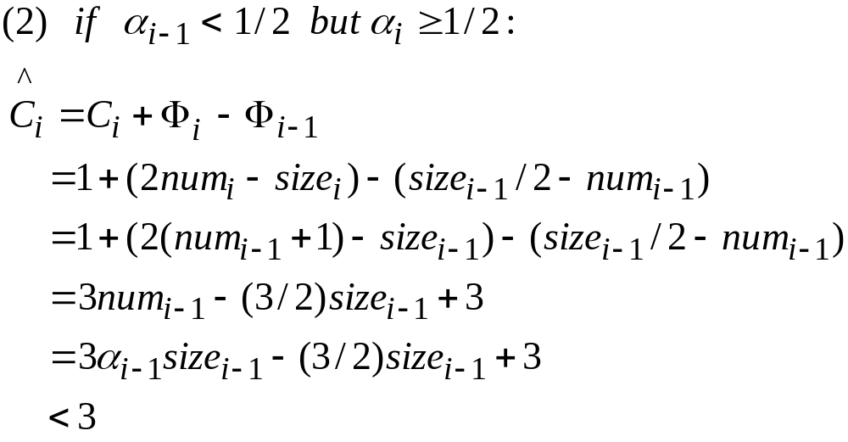

Slide 20
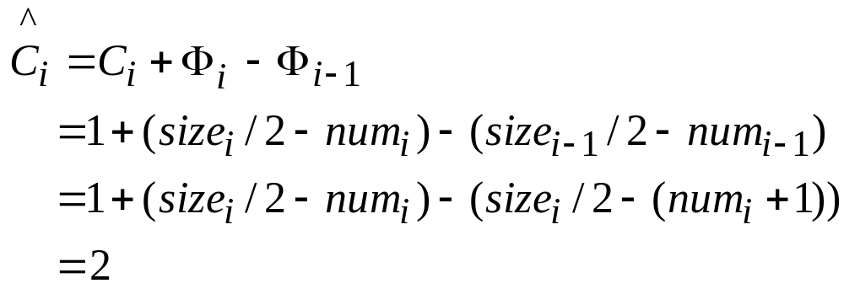
If the i-th operation is Table-Delete:

Slide 21
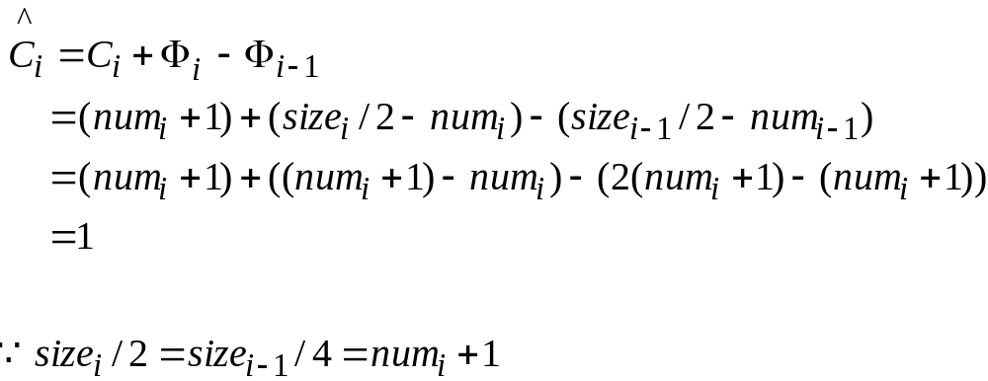

Exercise! 17.4-2.

